Slide 1
So you want to write a driver in Rust?
Alice Ryhl
Google

Slide 2

Who am I?
Upstream Linux:
  Android Binder driver
  Tyr GPU driver
Downstream:
  Android Ashmem driver
Userspace:
  Tokio
Alice Ryhl

Slide 3
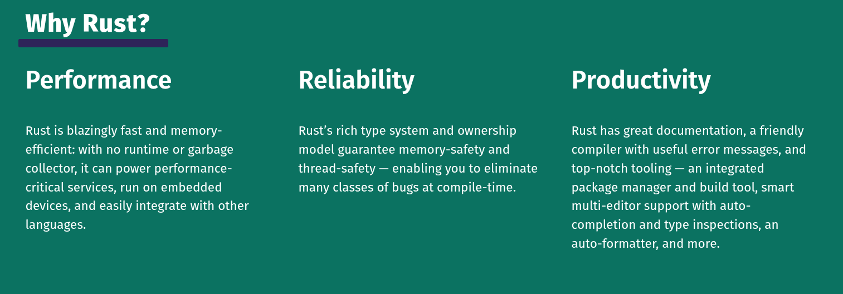
Why Rust?
rust-lang.org

Slide 4
Why Rust? Performance.
When picking a second language in Linux, we must pick something that can match C.
Rust is the only mature language that combines memory safety with being able to match C.

Slide 5
Why Rust? Reliability.
Reliability
Memory
safety

Slide 6
Why Rust? Reliability.
Reliability
Logic bugs
Memory
safety

Slide 7
Why Rust? Reliability.
Example: Reference counting.
  Rust’s ownership model prevents UAF with refcounted objects.
  Implemented using custom pointer type Arc<_>
  Question: What if there’s a bug in arc.rs?

Slide 8
Why Rust? Reliability.
Example: Reference counting.
  Rust’s ownership model prevents UAF with refcounted objects.
  Implemented using custom pointer type Arc<_>
  Question: What if there’s a bug in arc.rs?
  Answer: Imagine if you could guarantee that all refcounting bugs in your driver are actually bugs in include/linux/refcount.h

Slide 9
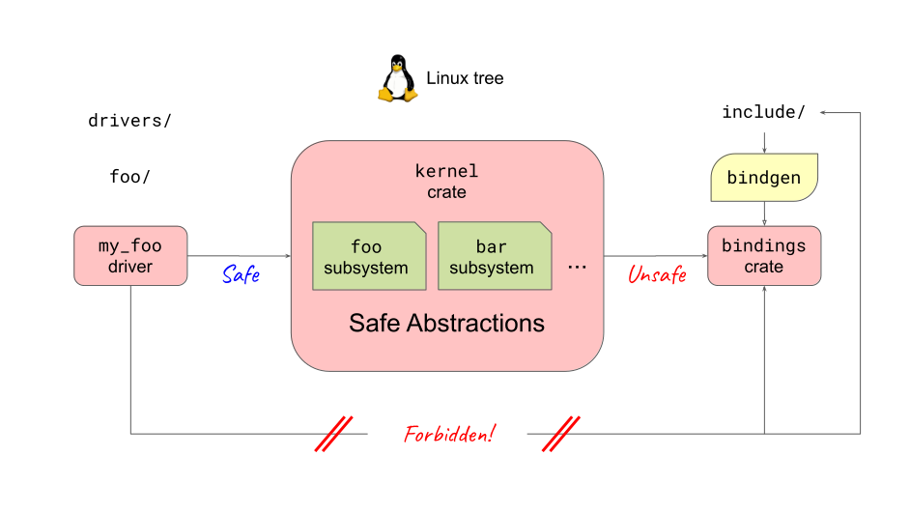
Unsafe Rust and encapsulation

Slide 10
Unsafe Rust in real-world drivers

Slide 11
Why Rust? Reliability.
“The Sophisticate: “The world isn’t black and white. No one does pure good or pure bad. It’s all gray. Therefore, no one is better than anyone else.”
The Zetet: “Knowing only gray, you conclude that all grays are the same shade. You mock the simplicity of the two-color view, yet you replace it with a one-color view….”
— The Fallacy of Gray

Slide 12
Why Rust? Productivity.
“If it compiles, it works.”
Ramp-up time.

Slide 13
Step 1. Compiling Rust
Documentation/rust/quick-start.rst
apt install rustc rust-src bindgen
make rustavailable

Slide 14
Sample drivers
samples/rust/rust_driver_auxiliary.rs
samples/rust/rust_driver_faux.rs
samples/rust/rust_driver_pci.rs
samples/rust/rust_driver_platform.rs
samples/rust/rust_misc_device.rs
And more...

Slide 15
MiscDevice sample
module! {
type: RustMiscDeviceModule,
name: "rust_misc_device",
authors: ["Lee Jones"],
description: "Rust misc device sample",
license: "GPL",
}

Slide 16
MiscDevice sample
struct RustMiscDeviceModule {
_miscdev: MiscDeviceRegistration<RustMiscDevice>,
}
struct RustMiscDevice {
...
}

Slide 17
MiscDevice sample
impl kernel::Module for RustMiscDeviceModule {
fn init(_module: &'static ThisModule) -> Result<Self> {
pr_info!("Initialising Rust Misc Device Sample\n");
Ok(RustMiscDeviceModule {
_miscdev: MiscDeviceRegistration::register(MiscDeviceOptions {
name: c"rust-misc-device",
}),
})
}
}

Slide 18
MiscDevice open
struct RustMiscDevice { }
#[vtable]
impl MiscDevice for RustMiscDevice {
type Ptr = KBox<RustMiscDevice>;
fn open(_file: &File, misc: &MiscDeviceRegistration<Self>)
-> Result<KBox<RustMiscDevice>>
{
let device = KBox::new(RustMiscDevice { }, GFP_KERNEL)?;
Ok(device)
}
}

Slide 19
Failure in Rust
enum Result<T, E> {
Ok(T),
Err(E),
}
struct result {
bool success;
union {
T ok;
E err;
};
};

Slide 20
Failure in Rust
fn fallible()
-> Result<&’static str>
{
if foo() {
return Err(EINVAL);
}
Ok(“my string”)
}
let string = fallible()?;

Slide 21
Failure in Rust
fn fallible()
-> Result<&’static str>
{
if foo() {
return Err(EINVAL);
}
Ok(“my string”)
}
let string = fallible()?;
match fallible() {
Ok(s) => println!(“{s}”),
Err(e) => {
// handle error
}
}

Slide 22
Failure in Rust
error: unused `Result` that must be used
--> src/main.rs:8:5
|
8 | fallible();
| ^^^^^^^^^^
|
= note: this `Result` may be an `Err` variant, which should be handled

Slide 23
MiscDevice example
Implement read/write.
Writing sets a string.
Reading returns the same string.

Slide 24
Data in a mutex
struct Inner {
data: KVec<u8>,
}
#[pin_data]
struct RustMiscDevice {
#[pin]
inner: Mutex<Inner>,
}

Slide 25
Data in a mutex
struct Inner {
data: KVec<u8>,
}
#[pin_data]
struct RustMiscDevice {
#[pin]
inner: Mutex<Inner>,
dev: ARef<Device>,
}

Slide 26
Writing to our MiscDevice
fn write_iter(mut kiocb: Kiocb<'_, Self::Ptr>, iov: &mut IovIterSource<'_>)
-> Result<usize>
{
let mut inner = kiocb.file().inner.lock();
// Replace buffer contents.
inner.buffer.clear();
let len = iov.copy_from_iter_vec(&mut inner.buffer, GFP_KERNEL)?;
// Set position to zero so that future `read` calls will see the new contents.
*kiocb.ki_pos_mut() = 0;
Ok(len)
}

Slide 27
Reading from our MiscDevice
fn read_iter(mut kiocb: Kiocb<'_, Self::Ptr>, iov: &mut IovIterDest<'_>)
-> Result<usize>
{
let me = kiocb.file();
dev_info!(me.dev, "Reading from Rust Misc Device Sample\n");
let inner = me.inner.lock();
// Read the buffer contents, taking the file position into account.
let read = iov.simple_read_from_buffer(kiocb.ki_pos_mut(), &inner.buffer)?;
Ok(read)
}

Slide 28
Learn more?
Official Rust resources at rust-lang.org/learn
  Read the book.
  Rustlings course
  Rust by Example
Linux
  Look at samples and real drivers
  Talk to us!
Other resources
  Comprehensive Rust
  Embedded book

Slide 29
Kinds of drivers
Phy, block, misc, drm, (pwm, hid)
Bus devices: pci, platform, aux, faux, (usb, i2c)
Pure data manipulation (such as QR code)

Slide 30
Other abstractions
Configfs, debugfs, dma, scatterlist, io, interrupt, of, opp, clk, iov_iter, tracepoint, kunit, kmalloc, vmalloc, kvmalloc, page, pid_namespace, security, cred, list, vec, rbtree, xarray, maple tree, bitmap, vm_area_struct, mmap, seq_file, mutex, spinlock, condvar, time, hrtimer, workqueue, uaccess

Slide 31
Going upstream
Ideal: entirely new driver
Dead code?
Duplicate drivers?
Reference drivers.

Slide 32
How is Rust introduced in a subsystem?
The ideal is that it becomes part of existing subsystem.
Additional maintainers or reviewers.
No Rust

Slide 33
Experimentation
Landing Rust code is an opportunity to learn Rust
Don’t let the possibility of bugs hold you back
Code should still build

Slide 34
Thank you for listening
Alice Ryhl <aliceryhl@google.com>

